Slide 1
Data and AI – Partner Technical Strategy
Contributors: Harsha Bennur, Sri Ganapathy, Thomas Mathew, Leslie Pickering, Rajeev Perera

Slide 2
Agenda
Ideas around partner offering strategy and profitability
Partner Offering examples
Keep learning and stay up to speed on this technology

Slide 3
Data and AI Flywheel
Analytics and AI
Data Modernization
Internet of Things
LSP
ISV
MSP
SI

Slide 4
Data and AI – Practice Building Blocks
Solution Areas
Solution Sales
Practices/Solution
Technical Sales Mapping
Products alignment
Data and AI
Data and Analytics SSP
Data Platform and Analytics
Business Intelligence TSP*
Power BI
Advanced Analytics TSP*
Azure Data Services, Power BI
Data Platform TSP
Azure Data Services, SQL Server, Azure Compute (Data VMs), BizTalk
Practice/Solution |  | Practice building block | Workloads
Data Platform and Analytics | Data Modernization | Data Platform Modernization and Mission Critical Applications | SQL: Data Platform Modernization SQL: Mission Critical Application Platform Azure-DA: Data Services (e.g. SQL DB)
 |  | Oracle Migration to SQL/Azure | SQL: Application Platform Migration
 |  | Data Warehousing and Big Data | SQL: Enterprise Data Warehouse SQL: Big Data Azure-DA: Big Data Azure-DA: Modern Data Warehouse
 | Analytics and AI | Business Analytics and AI | SQL: Advanced Analytics/R Azure-DA: Advanced Analytics Azure-DA: Cortana Analytics (Cognitive Intelligence)
 |  | Modern Business Intelligence | SQL: Business Intelligence O365: Power BI Pro
 | IoT | IoT PaaS Solutions | IOT: Remote Monitoring IOT: Predictive Maintenance
 |  | IoT SaaS Solutions | IOT: Remote Monitoring IOT: Predictive Maintenance

Slide 5
Data Modernization
Solution Ideas
Building Block | Typical Solutions
Data Platform Modernization and Mission Critical Applications | SQL Migration Assessment
 | Brillio Data Platform
 | Catapult Cloud Data Migration Managed Service
Oracle Migration to SQL/Azure | Oracle Migration with LegiTest – Pragmatic Works Cloud D
 | MDX for Oracle Experts – Capax Global
 | DB Best Oracle Migration assessment
Data Warehousing and Big Data | Decisions at your fingertips – SNP
 | Optimigrate
 | SQL Migration Workshop (Data Maturity Assessment, SQL 2017 and ADS, migration demo)
Top Partner Needs
 | Practice building blocks
Top Partner opportunities and resources | Modernization business value and market relevance
 | Competitive migrations from Teradata and Oracle
 | Access to engineering programs like DMS which is in private preview. StepUp series coming up in November.
 | Managed Instance (CloudLifter)
 | Data Platform Competency
 | SQL Always on/hands on labs – Data for Development and Data Insights Track
 | SQL Server on Linux
 | Oracle boot camp and partner practice playbook
 | APS to SQL DW engagements
 | SaaS offerings
Notes:
Business critical apps and Database Modernization – Microsoft has 37% share of the database market, however >50% of our installed base runs on SQL 2008 or older versions. Ensuring that customers are adopting SQL Server for new applications (SI or LOB) as well as upgrading to the latest version is a top monetization scenario. The upcoming product innovations (SQL Server 2017, Cosmos DB, Managed MySQL/Postgres) now allows us to extend our efforts across existing and new OSS and NoSQL applications and customers.
Hopefully the debrief "chalk talk" will lead to some ideas around possible solutions. If not, you will need to prompt the group with some ideas.
There will also be a slide with pre-populated ideas.
You'll also spend some time talking about ways partners can be profitable
Finally you'll talk about top questions/needs a partner might have in this area
We would do similar slide for all four pillars
Solution ideas will entail solutions in each pillar
Talk smart – what would they be able to talk about in each of these pillars
Top partner needs/questions

Slide 6


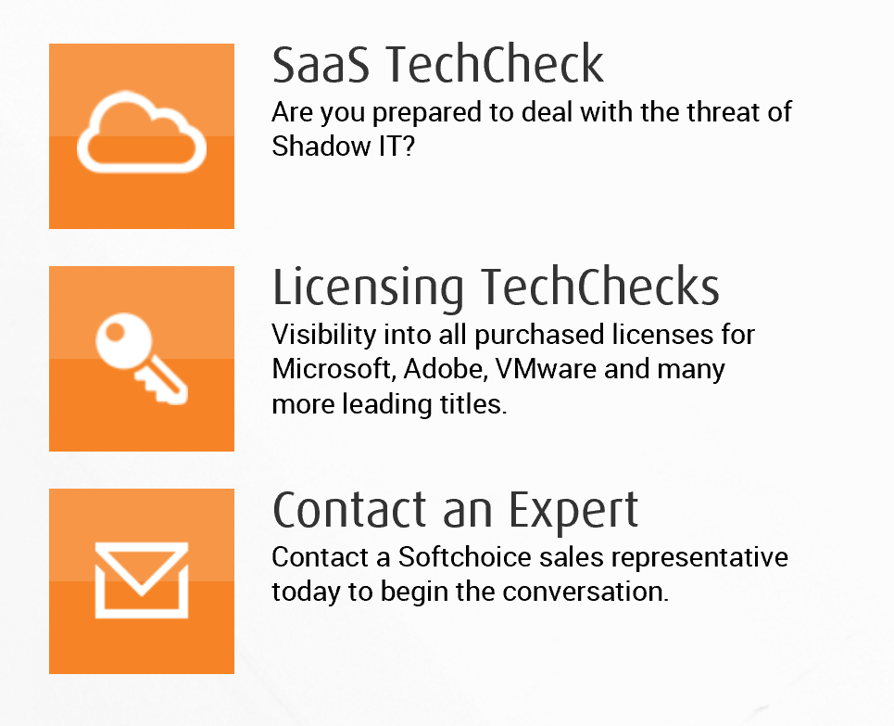
Softchoice Tech Check
Cloud Maturity
Cloud Incompatible
Cloud Compatible
Cloud Deployed
Cloud Connected
Cloud First
Cloud Native
Digital Transformation
Softchoice has generated extensive intellectual property over many years and consolidated it into a TechCheck portfolio is designed to help you explore your current state and determine where gaps exist
PTS led:
Understand partner growth plans around SQL and Data Practice
Discuss SQL Modernization as a play in their Tech Check offering
Identify current enablement needs and skills gap
Train the trainer workshop - PPE on Data Modernization
PDM led:
Marketing campaign across different geos with customers
CSA led:
Tools discussion/Private preview of DMS were included in the offering with CSA assistance (Rishi)
Evaluated and co-delivered first workshop with the partner
Traditional
Evolving
Transformed
Notes:
Chilis, Olive Garden, Red Robbin – Over 3000 restaurants
Early Adopters of Azure
Event Hub and their own device provisioning
Growing at a rapid pace
Invested in APS
IT team not happy with their own inability to size & cost

Slide 7
Analytics and AI
Solution Ideas
Building Block | Typical Solutions
Business Analytics and AI | Bots for BusinessBOTs are artificially intelligent agents that understand and interact to drive your business forward
 | Optimix Optimix enables what-if scenarios to set accurate promotion budgets that fits your business goals. (Marketing)
 | Smart Asset Management With billions of dollars of investment in assets, the utility industry faces major issues monitoring their assets & supplying energy to customers without interruptions. Delivering high impact & simple solutions for a new technology-enabled world, SAM uses the Brillio Data Platform & predictive analysis to look into the health of assets effectively & efficiently. (Manufacturing)
Modern Business Intelligence | Shelf Scanner for CPGBrillio Shelf Scanner for CPG provides Real Time Visibility and Insights into in-store execution (CPG and Retail)
 | Voice of the Customer (Social Media Intelligence) Handles unstructured public data to evaluate user needs & insights for brand & reputation management (Retail/Marketing)
 | Predict Product QualityPredict product quality and reduce waste (Manufacturing)
Top Partner Needs
 | Practice building blocks
Top Partner opportunities and resources | Selling Business Intelligence Solutions with Microsoft
 | Insights is a journey – data – reports – dashboards – predictive models – recommendations .
 | 78% of Analytics and AI projects driven by LoB and business owners
 | Cognitive Services
 | Book of Dreams and Solution Maps
 | Showcase applications on AppSource or PowerBI AppSource Solution Showcase (SaaS apps), Analytics Solution Showcase, Power BI Solution Showcase
 | Competency – Data Analytics
 | Margins of 35-45%
Notes:
We would do similar slide for all four pillars
Solution ideas will entail solutions in each pillar
Talk smart – what would they be able to talk about in each of these pillars
Top partner needs/questions

Slide 8
Advanced Analytics and Intelligence solutions
Vertical | Sales & Marketing | Finance & Risk | Customer & Channel | Operations & Workforce
Retail | Demand Forecasting Loyalty Programs Cross-sell & Upsell Customer Acquisition | Fraud Detection Pricing Strategy | Personalization Lifetime Customer Value Product Segmentation | Store Location Demographics Supply Chain Management Inventory Management
Financial Services | Customer Churn Loyalty Programs Cross-sell & Upsell Customer Acquisition | Fraud Detection Risk& Compliance Loan Defaults | Personalization Lifetime Customer Value | Call Center Optimization Pay for Performance
Healthcare | Marketing Mix Optimization Patient Acquisition | Fraud Detection Bill Collection | Population Health Patient Demographics | Operational Efficiency Pay for Performance
Manufacturing | Demand Forecasting Marketing mix Optimization | Pricing Strategy Performance Risk Management | Supply Chain Optimization Personalization | Remote Monitoring Predictive Maintenance Asset Management

Slide 9

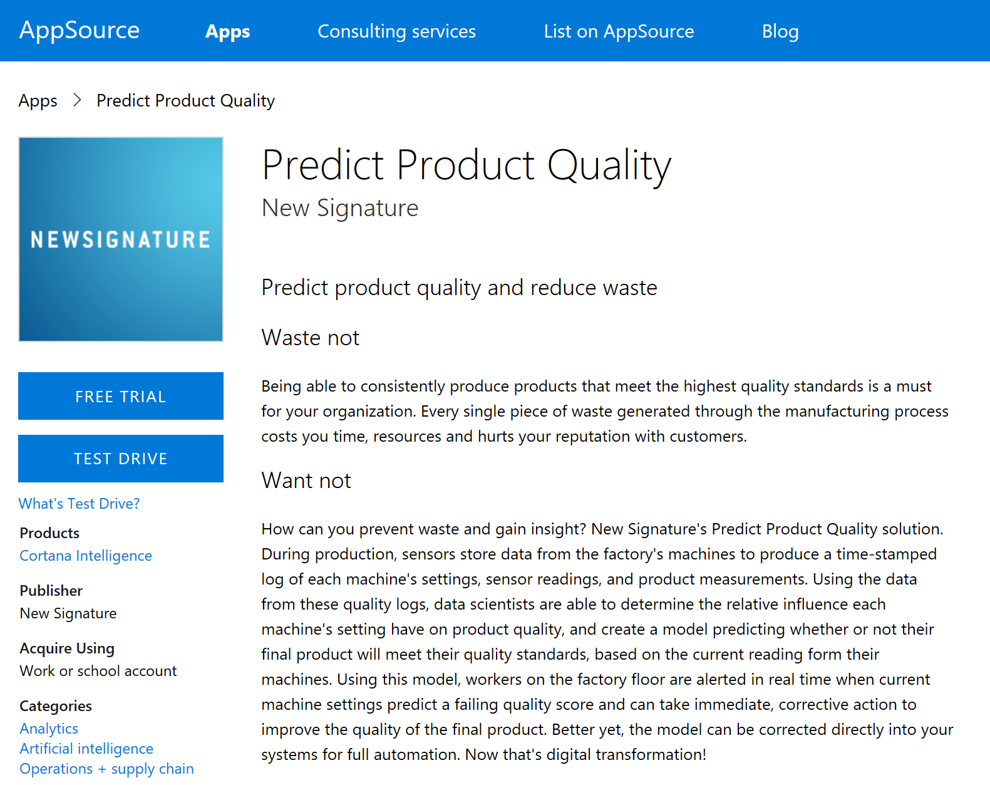
New Signature’s Predict Product Quality
Cloud Maturity
Cloud Incompatible
Cloud Compatible
Cloud Deployed
Cloud Connected
Cloud First
Cloud Native
Digital Transformation
Traditional
Evolving
Transformed
Softchoice has generated extensive intellectual property over many years and consolidated it into a TechCheck portfolio is designed to help you explore your current state and determine where gaps exist
PTS led:
Understand the partner engagements and opportunity for repeatable IP
Discuss evolution of Predict Product Quality Offering
Enablement needs and offering profitability/margins
Cheat Sheet and sales enablement
PDM led:
Marketing campaign and Industry alignment
CSA led:
Offering design sessions
Framework and algorigthms for ML
Tweak offering based on customer learnings
Offering components:
30 Minute Intro Call, Quick Start, Use Case Workshop, Six Weeks to Insights, Integration with sensors, actions
Notes:
Chilis, Olive Garden, Red Robbin – Over 3000 restaurants
Early Adopters of Azure
Event Hub and their own device provisioning
Growing at a rapid pace
Invested in APS
IT team not happy with their own inability to size & cost

Slide 10
IoT
Solution Ideas
Building Block | Typical Solutions
IoT PaaS Solutions | Saviant – SEAP Use your existing systems & data to Predict Outcomes & Prevent Failures of your Assets & Operations (Energy and Utilities)
 | Connected Field Service - Mariner
 | Retail Edge – Hitachi Consulting Optimized Factory – Hitachi Consulting
IoT SaaS Solutions | Predictive Maintenance, Remote Monitoring – all IoT partenrs
 | Connected Health Connected Infrastructure Connected Living Connected Maintenance Connected Operations Energy Management Remote Monitoring Parcel Tracking Smart Building
 | Insights as a service (CSP)
Top Partner Needs
 | Practice building blocks
Top Partner opportunities and resources | Partners need to understand Lambda architectures
 | Industry focus
 | Selling IoT as a point solution versus end to end solution
 | Selling complexity due to longer sales cycle and partner ecosystem dependence (Position SaaS offering as a way to address and point solutions
 | Microsoft IoT Partner Directory
 | Azure Certified for IoT devices
Notes:
Hopefully the debrief "chalk talk" will lead to some ideas around possible solutions. If not, you will need to prompt the group with some ideas.
There will also be a slide with pre-populated ideas.
You'll also spend some time talking about ways partners can be profitable
Finally you'll talk about top questions/needs a partner might have in this area
We would do similar slide for all four pillars
Solution ideas will entail solutions in each pillar
Talk smart – what would they be able to talk about in each of these pillars
Top partner needs/questions

Slide 11


Hitachi Retail Edge
Cloud Maturity
Cloud Incompatible
Cloud Compatible
Cloud Deployed
Cloud Connected
Cloud First
Cloud Native
In 2017, nearly 10,000 stores in the United States will close.¹ Brick-and-mortar retailers struggle against online competition because of the inability to quickly change product prices, high overhead costs, embedded biases in supply chain decision-making and the lack of rich customer engagement.
Hitachi Retail Edge is a flexible IoT technology installed on existing retail store shelving that delivers an online experience and drives efficiencies through automation. It provides the technology and infrastructure to enable automated pricing, beacons, cameras, ambient lighting, out-of-stock indicators and environmental monitoring
PTS led:
Solution envisioning discussion
Discussion around partner profitability/industry relevance – Industry team engaged
Microsoft IoT offerings discussion
Architecture review of existing design
PDM led:
IoT accelerate program nomination
CSA led:
Architecture design session to include Microsoft services
Hackathon to create a PoC – Planned
Work with engineering for roadmap discussions and inclusion in design - Planned
Customer pilot technical engagement – Planned
Digital Transformation
Traditional
Evolving
Transformed
Notes:
Chilis, Olive Garden, Red Robbin – Over 3000 restaurants
Early Adopters of Azure
Event Hub and their own device provisioning
Growing at a rapid pace
Invested in APS
IT team not happy with their own inability to size & cost

Slide 12
ISV Solution Idea

Slide 13
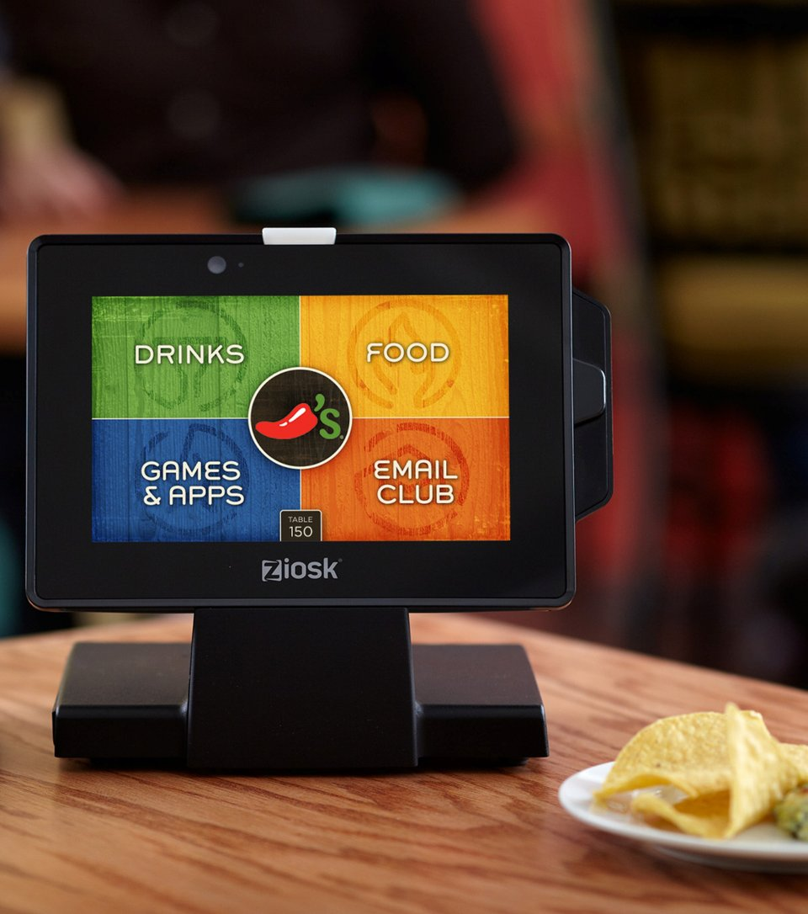
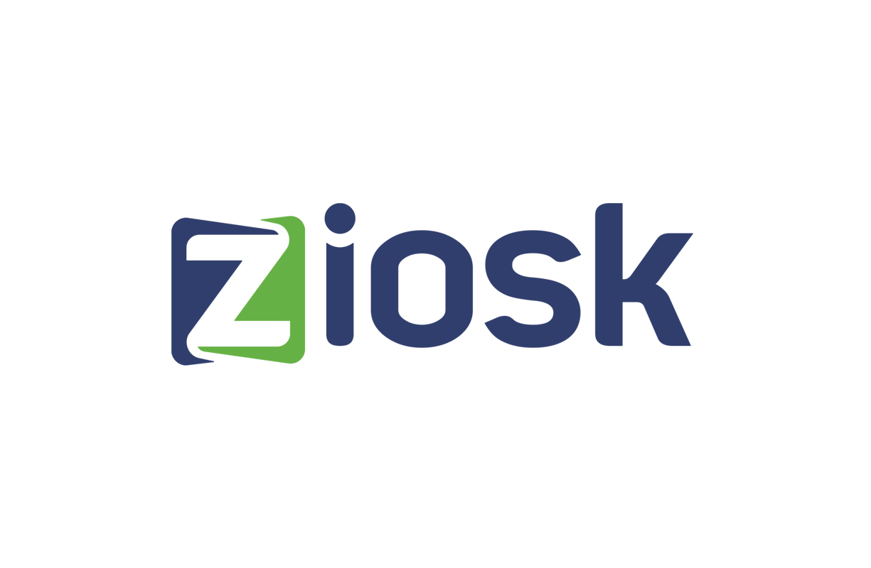

Data Monetization with real-time analytics
Cloud Maturity
Cloud Incompatible
Cloud Compatible
Cloud Deployed
Cloud Connected
Cloud First
Cloud Native
Digital Transformation
Traditional
Evolving
Transformed
> 4000 restaurants – Chili's, Olive Garden
170,000 tablets with more than 50 million guests per month
Early adopter of Azure (PaaS)
Data stored in Azure Storage Blobs with no insights (Survey, AppStream, Check, Telemetry)
Previously invested in on-premises APS appliance
NextGen platform to enable personalized experiences – Food recommendation, Alerts, Device Health, Menu Optimization etc.
Azure IoT Hub solution is being rolled out to restaurants
Notes:
Chilis, Olive Garden, Red Robbin – Over 3000 restaurants
Early Adopters of Azure
Event Hub and their own device provisioning
Growing at a rapid pace
Invested in APS
IT team not happy with their own inability to size & cost

Slide 14
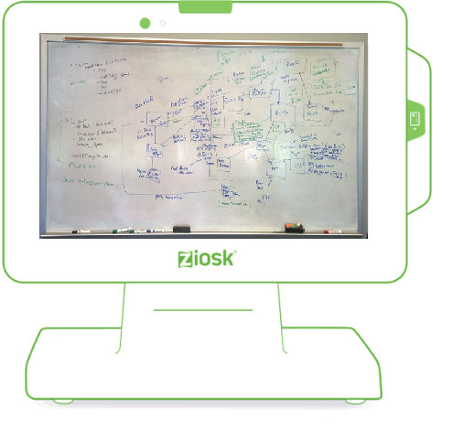
Ziosk Engagements
Vision of the Possible Whiteboard
PTE Led
Kickoff call with Data Platform team
On-site Strategy session with the Ziosk Data Platform team
Met with the founder, CTO and CSO to understand NextGen Solution vision
Envisioning ADS resulting in identification of all potential areas to engage
Bi-weekly calls resulted in Ziosk developing draft NextGen Architecture
Onboarded 6TB of data on Azure SQL DW under Free trial
Event Hub data from all 3000 restaurants funneling into Azure SQL DW
Migrated Event Hub to IoT Hub
Swarm & Product team engaged on
Hackthon for App click-through data
Hackthon to build end to end Solution
APS to DW Migration Effort with Product Team – On going
Next Steps – Hack on Branded Portal and PowerBI Embedded
Notes:
HoloLens
Working with 2 HiPo teams and AE
Pace of the project
Free 1 month Trial Offer
Device conversation put on hold
Issues with Data warehouse resizing
Data Lake as intermediary
Building a Model to share with other customers

Slide 15
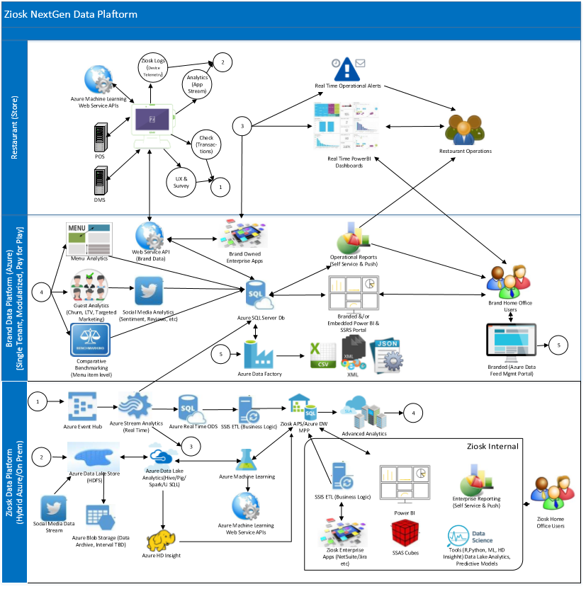
Ziosk NextGen Data Platform

Slide 16
Ongoing Learning – Data and AI
Ongoing Friday Best Practice Learning Series - Pod/Swarm best practices sharing
Blogs to follow: Stay up to date on partner opportunities by following this blog series
YouTube channels: Data on Microsoft Mechanics, Cloud Platform SQL and AI Channel, Cloud Platform - IoT Channel, Microsoft Power BI YouTube Channel
Sites on InfoPedia: Data and AI, IoT
Learning Plans: Business Analytics, Data Platform Modernization, IoT
Exams/Certs: Data Analytics Competency, Data Platform Competency,
Twitter: @msuspartner, @mscloud, @SQLServer @MSAdvAnalytics ,
Community Resources: Yammer Group, Community Blog, Enablement Blog
Test Environments
Dashboard In a Day, Power BI Sales demo, Power BI Finance demo, Power BI Marketing demo
IoT customer workshop-in-a-box
Hands on labs, AdventureWorks SkiResort App demo
OCP Swarm Team
Rajeev Perera (Manager)
BG/CxP Resources
Kelly Erasmus – Data/Compete
Manav Bhatia (OCP)
Links to Resources
https://www.microsoft.com/en-us/CloudandHosting/Azure_Services_Resources.apsx#understand
Data Maturity Model tool
Cloud and Enterprise Partner Resources
Partner Toolbox
M&O Resources
Leslie Kwoh, Bill O’Brien
Notes:
Sign up for monthly partner community calls
Join the partner yammer discussion
Stay up to date on partner opportunities by following this blog series

Slide 17
Executive View

Slide 18
Q&A

Slide 19
Appendix

Slide 20
Practices/Solutions and Practice building blocks
Modern Workplace
Practice/ Solution | Practice building blocks
Collaboration | Modern Collaboration and Effective Teamwork
 | Employee Engagement and Empowerment
 | First Line Workers
Modern Desktop | Modern Desktop Deployment
 | Modern Desktop Managed Services
Security and Compliance | Enterprise-level Identity protection
 | Control and protect information
 | Regulatory compliance
 | Proactive attack detection and prevention
Cloud Voice | Modern Meetings with PSTN dial-in
 | Cloud PBX enablement
Business Applications
Practice/ Solution | Practice building blocks
Customer Engagement | Customer Service
 | Field Service
 | Project Service Automation
 | Sales
Operations | Talent Management
 | Retail
 | Finance and Operations
Business Apps | Finance and Operations
 | Sales
 | Marketing
Apps and Infrastructure
Practice/ Solution | Practice building blocks
Cloud Infrastructure and Management | Hybrid Networking
 | Hybrid Storage
 | High Performance Computing
 | Data Center Transformation
 | Windows Server Apps on Azure
 | Extending Azure with Azure Stack
 | Development and Test + DevOps
 | SAP on Azure
 | Red Hat on Azure
 | Hybrid Infrastructure Security and Management
 | Backup, Archive, and DR
Application Innovation | DevOps
 | Customer Facing – Digital Marketing
 | Customer Facing – Mobile
 | Customer Facing – Transactional Apps/eCommerce
 | Customer Facing – Gaming
 | Customer Facing – Media
 | App Modernization and Integration
Data and AI
Practice/ Solution | Practice building blocks
Data Platform and Analytics | Data Platform Modernization and Mission Critical Applications
 | Oracle Migration to SQL/Azure
 | Data Warehousing and Big Data
 | Business Analytics and AI
 | Modern Business Intelligence
 | IoT PaaS Solutions
 | IoT SaaS Solutions
Industry/Horizontal Solutions
Notes:
Title
Sub-topics
Overview

Slide 21
Resources
CE Portal - http://aka.ms/ceportal
Business Model Guide – Partner Business Model Guide to pragmatically approach Ideation and Innovation exercises
Practice Development Playbooks:
aka.ms/cloudsecurityplaybook
aka.ms/cloudappdevplaybook
aka.ms/dataplatformplaybook
aka.ms/cloudinfraplaybook
aka.ms/mobilityplaybook
https://partner.microsoft.com/en-us/business-opportunities/build-a-practice
Industry Book of Dreams
https://microsoft.sharepoint.com/teams/servicesportfolio/enterprisestrategy/SitePages/Book%20of%20Dreams.aspx

Slide 22
Cortana Analytics Key Verticals
Retail
Healthcare
Financial Services
Industry Overview
$22 trillion global revenue ($4.7 trillion U.S.)
4% annual growth rate
3.7 million businesses
42 million employees
Industry Trends
Commerce anywhere, anytime
Personal and in context
Scenarios
Sales & Marketing: Demand Forecasting
Customer & Channel: Personalized Offers
Industry Overview
$2 trillion spent in U.S./year on healthcare
5,754 hospitals with >36 million patients
Hospital readmissions cost ~$41 billion/year
ACA new regulations for Medicare/Medicaid
Industry Trends
Payments based on patient outcome
Government monitoring hospital readmissions and number of hospital-acquired conditions
Scenarios
Customer & Channel: Patient Outcomes
Operations & Workforce: Operational Efficiency
Industry Overview
7.9% of US Economy
$1.2 trillion revenue
12% revenue growth rate
5.9 million employees
Industry Trends
Understanding customer behavior
Cybersecurity
Taking banking “mobile”
Proactive regulatory compliance
Scenarios
Finance & Risk: Risk & Compliance
Sales & Marketing: Personalization
Notes:
As we’re looking at key scenarios, we’re also finding industries in which the radical change in the market is driving innovation and opportunity for our field. For example, in Retail the explosion of online shopping has put a strain on brick and mortar stores not only in staying relevant and connected, but also stocking the right thing at the right time. In Healthcare, the Affordable Care Act’s focus on paying for performance in positive patient outcomes makes a data-driven culture no longer optional. And it’s impossible to miss in the news how the marketplace and regulatory focus has changed infrastructure needs in the financial services industry. You’ll see marketing making specific investments in content in these areas in the coming months.

Slide 23


Top ISV solutions in Enable Hybrid Data Platform
Atavault
NetApp AltaVault cloud-integrated storage enables customers to securely back up data to any cloud at up to 90% less cost compared to on-premises solutions. AltaVault gives customers the power to tap into cloud economics while preserving investments in existing backup infrastructure and meeting backup and recovery service levels. Key Use Cases/ Benefits Seamlessly integrates into existing infrastructure Deduplicates, compresses, and encrypts Caches recent backups locally, vaults everything to the cloud Store data in the public or private cloud of choice
Availability: Global Average Deal Revenue: $7.7K Link to Marketplace
For SQL Server
ScaleArc’s database load balancing software enables continuous availability of SQL Server-based apps. The software drops into existing environments and enables auto failover that’s transparent to the app – within or between data centers. The software also helps Azure migration, since the software can aggregate smaller database instances and enable cross-region failover. Key Use Cases/ Benefits Easy deployment, configuration and management Centralized web, application and device management Centrally managed encryption capabilities Mobile security and management
Availability: Global Average Deal Revenue: $20.7K Link to Marketplace

Slide 24


Top ISV solutions in Data Warehousing (EDW)
Converged data Platform
MapR provides the industry's only converged data platform that integrates the power of Hadoop and Spark with global event streaming, real-time database capabilities, and enterprise storage, enabling customers to harness the enormous power of their data. A majority of customers achieves payback in fewer than 12 months and realizes greater than 5X ROI. Key Use Cases/ Benefits MapR’s NoSQL database requires less administration MapR supports the broadest array of Hadoop components MapR is 2-5x faster than HDFS based distributions MapR was designed to scale to exabytes
Availability: Global Average deal Revenue: $200K Link to Marketplace
Analytic database
EXASOL’s high-performance, in-memory technology allows companies to run analytic projects today that previously weren’t possible with legacy database technology. Enables companies turn their staff into data experts and data heroes by unearthing business value from day one. Key Use Cases/ Benefits Combines in-memory, columnar storage and massively parallel processing technologies to provide unrivalled performance Grows with your data volumes, extends your system and increase performance by adding additional nodes compatible with leading ETL and BI products such as Tableau as well as Hadoop
Availability: Global Average Deal revenue: $8K/Quarter Link to Marketplace

Slide 25

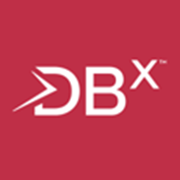
Top ISV solutions in Data Warehousing (EDW)
Podium Data
Podium is a data lake management software platform that radically improves the way enterprises manage, prepare, deliver and use business-critical information. Purpose built to leverage the performance and economic advantages of Hadoop, Podium helps organizations deliver data securely to the enterprise at a fraction of the time and cost associated with traditional data management approaches. Key Use Cases/ Benefits Gives business users self-service access to business-ready data in a secure repository Replace today’s costly web of redundant databases and data flows with a consolidated, scalable management platform Podium enables agile collaboration
Availability: Global Average Deal Revenue: $50K Link to Marketplace
XtremeData dbX
Simple, fast, massively scalable data warehouse to ingest, integrate and analyze big data in the shortest time and least cost. Substantially reduces development time, supports existing data models and BI/ETL tools, and augmentation of new big data sources without data model redesign. Dramatically lower TCO and supports “pause mode” to avoid spend when not in use. Key Use Cases/ Benefits Enables customer to evolve to a massively scalable SaaS platform Reduces cycle time from a week to hours for integrating massive amounts of online/offline data Accelerated implementations and eliminated data warehouse development by leveraging OLTP data models for BI/reporting
Availability: Global Average Deal revenue: $65K Link to Marketplace

Slide 26


Top ISV solutions in Business Critical Application Platform
SnapCloud
Massive data growth has created significant scaling issues for IT management teams. The SnapCLOUD storage portfolio enables customers to manage and share data with agility and control over its life cycle both on-premise and in the cloud. This solution delivers end-to-end data protection for data that is accessed, shared and migrated to-and-from on-premise & cloud, while lowering infrastructure spend. Key Use Cases/ Benefits On-demand enterprise NAS storage growth at your finger tip Simplicity of provisioning full featured NAS storage in minutes Central orchestrator to manage all enterprise storage along with SnapCLOUD from a single web based tool Built-in sync and share to deliver data on any device, any where
Availability: Global Average Deal Revenue: $10K
DB2 Advanced Workgroup Server
IBM® DB2® Advanced Workgroup Server provides an expansive database solution for midsize companies. It is the ideal multi-workload database solution that offers data warehousing, transactional and analytics capabilities. IBM DB2 Advanced Workgroup Server Edition provides storage optimization, system availability, workload management and performance to help reduce overall database costs. Key Use Cases/ Benefits Best-in-class data solutions to address every information need Broadest and most comprehensive solution portfolio aligned to a big data & analytics strategy Only vendor infusing cognitive capabilities into its data strategy Industry leading innovation with huge investments in research and development, driving a record number of patents each year
Availability: Global

Slide 27


Top ISV solutions in Application Platform Migration
Applications Anywhere
We help ISVs and Corporate IT re-purpose classic Windows XP or browser-dependent applications for deployment onto Windows 10 devices and Azure or hybrid cloud. We’re different because our patented container technology was designed to plug the gaps in the Microsoft solution stack for Windows 10 and Azure application management. Key Use Cases/ Benefits Immediate ‘lift & shift’ of any application to Windows 10 or Azure Enables apps tied to IE 6/7/8/9/10 to be deployed to WIN 10 or Azure Turns IE into a runtime component, thereby reducing vulnerability threat Enables application management as a service, at scale, from Azure
Availability: Global
Server 12
By incorporating the automation and DevOps functionalities that Chef offers with Azure, enterprises can transform their IT organizations to be more agile. Chef helps customers light up their Azure platform to migrate existing workloads to Azure, enable web-scale IT, and maximize their usage of Azure. Key Use Cases/ Benefits Adjust IT to meet dynamic business needs without disruption or delay Integrates with Azure to provide a fully automated experience Bring speed to configuration and implementation saving time and money Web-based management console lets you view and customize your Chef installation
Availability: Global Average Deal Revenue: $22K

Slide 28
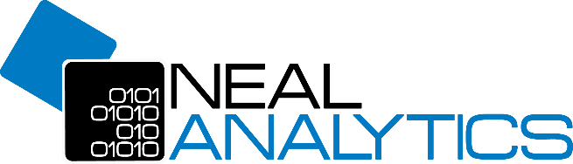

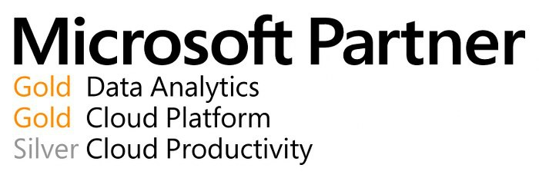
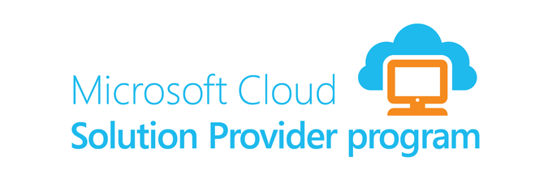
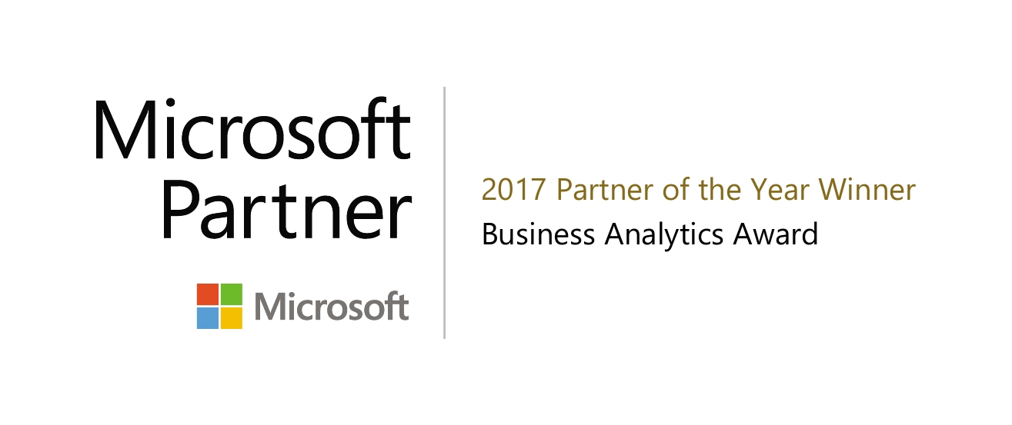
Neal Analytics Retail IQ
GOAL:
Increase sales by having the right product portfolio for every customer
SKU Max Inventory Optimization Solution Overview
How can I identify which products are trending in my market?
Optimize Sales with Actionable Insights
How do I optimize our shelf space for maximum revenue?
David McClellan
Practice Director: Retail and CPG
Microsoft Cloud Hosted Architecture
Azure SQL Data Warehouse, Azure Machine Learning, Azure Storage, Azure Data Factory, Power BI, HD Insight

Slide 29
Transition from Services to Solutions
Services
Solutions
Predictive Analytics
Data Science Modeling
Inventory Optimization
Trade Promotion Optimization
Data Engineering
Digital Transformation
Advanced Demand Forecasting
Notes:
Neal Analytics is an example of one our top partners that made the transition from being focused on Services only to Solutions. This helps them actually sell more of the underlying technology services but by aligning them with key customer business problems.

Slide 30
Data Platform Modernization Play Blueprint
1
PARTNER SCENARIOS
(PRACTICE BUILDING BLOCKS)
SOLUTION AREA
PLAYS
Data Platform Modernization and Mission Critical Applications
Modern Business Intelligence
Data and AI
DW and Big Data
Oracle Migration to SQL/Azure
IOT PaaS Solutions
Modern Business Intelligence
DW and Big Data
IoT SaaS Solutions
Business Analytics and AI
Business Analytics and AI
Internet of Things
Data Platform Modernization
SALES CONVERSATIONS
(CONVERSATIONS WITH CUSTOMERS)
PITCH ELEMENTS
PRODUCT PULL-THROUGH
PARTNER PLAYBOOK
2
3
Modernize existing apps
Make applications Cloud ready, shift OSS and distributed apps to Cloud
SQL Server 2017, Azure SQL DB, Azure Postgres, MySQL, Cosmos DB
Written by Partners: What does a partner need to set up a Data and AI Practice
Data Platform & Analytics Playbook
Modernize Oracle and Teradata workloads
Modernize your Data Estate, most complete data platform
SQL Server 2017, Azure SQL DB
Build new apps
Build for global scale on your choice of platform
SQL Server 2017, Azure SQL DB, Azure Postgres, MySQL, Cosmos DB
Notes:
Aka.ms/copartners
Modernize and Renew
Migrate to Azure
Extend with BI, Analytics and IoT

Slide 31
Technical Strategy Debrief Business Apps Contributors: Barb Borrowman, Karen Moen, Renato Leite, Mani Ramachandran, Tom Taylor, Anjali Justus https://aka.ms/ocpbusinessapps

Slide 32
Agenda
Business Apps debrief/Ask us anything
Dynamics Partners – Characteristics, Offering strategy
Top questions that partners ask on this workload
What you need to know? Why you should care?
Keep learning and stay up to speed on this technology
https://aka.ms/ocpbusinessapps
Notes:
Karen

Slide 33
Dynamics Quiz
What does the acronym CRM mean?
Customer Relationship Management = Dynamics 365 Customer Engagement
What apps are part of Customer Engagement?
Sales – Customer Service – Field Service – Project Service Automation
What does the acronym ERP mean?
Enterprise Resource Planning = Dynamics 365 Unified Operations
What apps are part of Unified Operations?
Finance & Operations – Talent – Retail
What would the Azure App Solution from yesterday look like on Dynamics?
Notes:
Karen

Slide 34
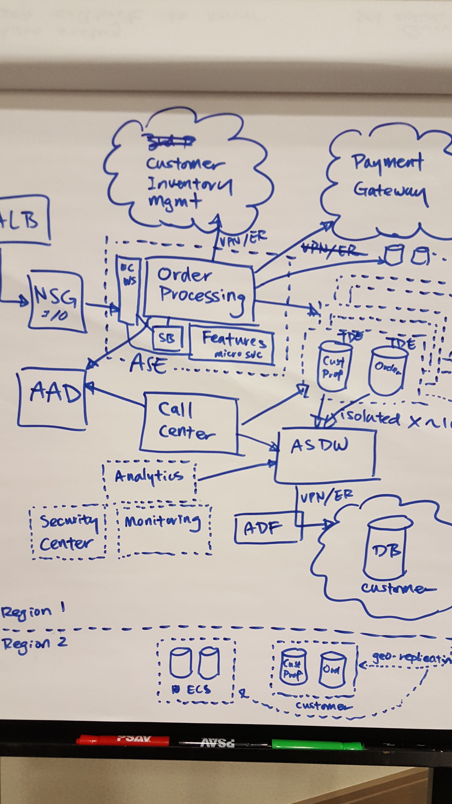
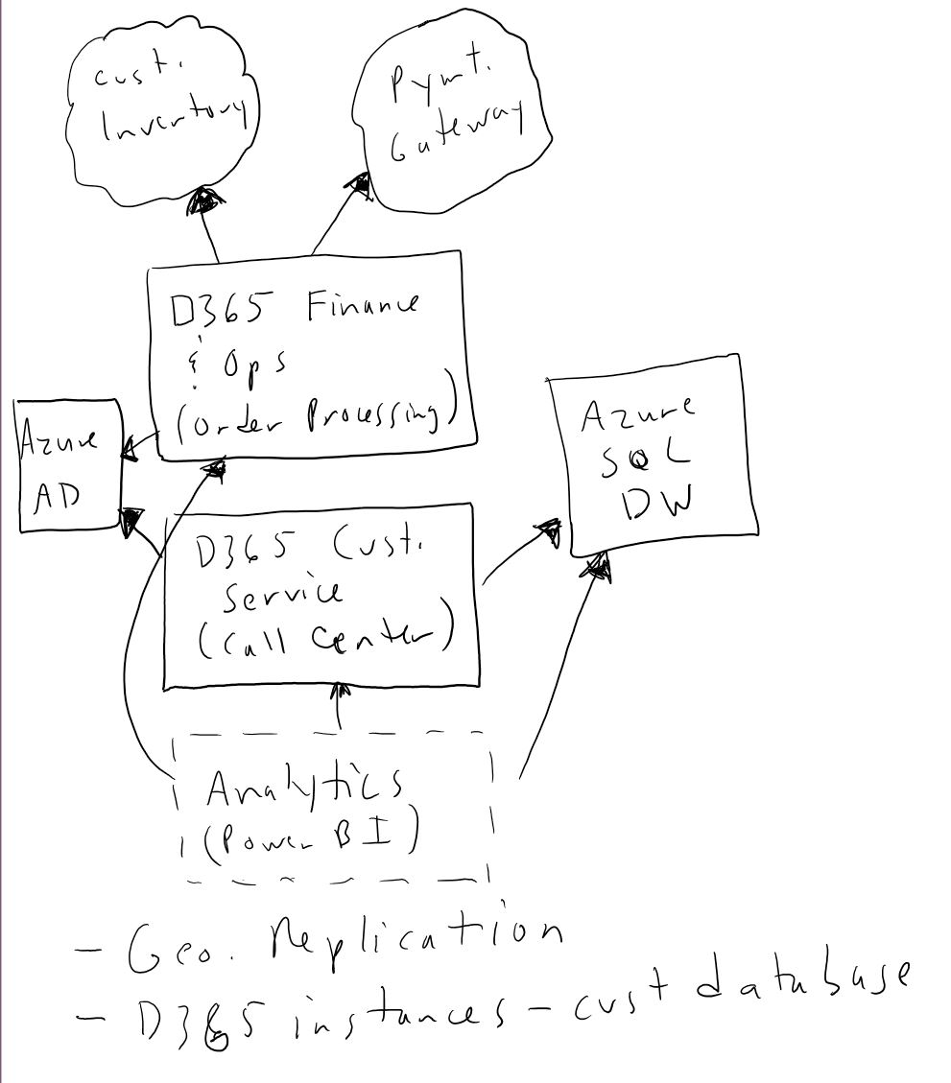
Notes:
Karen

Slide 35






Dynamics 365 enables this new world
Dynamics 365
INSIGHTS
Marketing
CRM
ERP
Talent
Sales
Dynamics 365
Retail
Field Service
Finance and Operations
Customer
Service
Project Service Automation
BUSINESS PROCESSES
Azure
Power BI
PowerApps
Microsoft Flow
Common Data Service
Office 365
Notes:
Karen
Dynamics partners know and talk to the business. It touches every pillar of Digital transformation.
All customers have the back end systems to run their business. Ask the question.
* For example, if you are building a cool front end app on Azure – what are the business systems on the back end?
How to we impact Azure and O365?
Opportunities Azure
Data & Analytics – do our customers need data to make business decisions? Where is the data? In the business apps.
Machine Learning
IoT
integration.
TODO: find the links to Azure slide!
Integration with O365
Outlook - no need for separate mobile client -
Use data in Exchange + Dynamics Sales to give a customer relationship score.
SharePoint = Office Groups – Teams?

Slide 36




Dynamics Partner
Leads with the Cloud
Telephony
Offers a comprehensive solution
ERP
CRM - Customer Engagement
Deeply understands customers’ business processes
Document Management & Workflows
Dynamics
Partner
Owns customers’ technology strategy
Office 365
Owns solution integration and validation
Customer
BI, IoT, Dashboards
Business Consulting
Owns the billing relationship
Mobile Access
Offers managed services including support
Notes:
Barb to cover
What is a typical Dynamics partner?

Slide 37
Dynamics 365
one platform – many applications
Anything
management
Supplier management
Student management
Patient management
Contracts management
Veteran
management
Recruiting
management
Asset management
Risk
management
Offender management
Vendor management
Azure
Power BI
PowerApps
Microsoft Flow
Common Data Service
Office 365
Notes:
Barb to cover

Slide 38
Business Apps: Customer Engagement
Solution Ideas
Building Block | Typical Solutions
Customer Service | Call Center & Support Services, Customer Relationship & Issue Management, Omni-channel engagement (self service, call center, click to chat, co-browse), Agent enablement, Social Media Monitoring/Brand Sentiment
 | Key terms: Cases, Knowledge base articles, self service portals, click to chat, Customer 360, SLAs
 | Examples: Help Desk, Support Organizations, Contact Center
Field Service | On-site service for home/business, Management & scheduling of field resources, Proactive Maintenance with IoT, Omni-channel, Inventory management, Just in time maintenance
 | Key terms: work orders, dispatching, resource scheduling, skills proficiency
 | Examples: Home Grocery delivery, Home repair & monitoring, Thyssen – Elevators, Boeing, Hospice at Home, Utilities Install & Repair
Project Service Automation | End-to-end Project Lifecycle Management; Customer engagement for sales, resourcing, delivery and billing; Plan, estimate & price multi-day engagements; Optimize resources for maximize billing time; Track Project profitability
 | Key terms: work breakdown structure, resource scheduling, project estimates & actuals, time & expenses
 | Examples: Architecture/Engineering/Construction, Professional services, IT Consulting
Sales | Sales Process & Customer relationship management, Social Selling, Intelligent Sales Engagement (Lead scoring, Improve win rates, predictable sales forecast, pipeline velocity, consistent customer communication), Track wins/losses.
 | Key terms: accounts, contacts, opportunities, leads, products, quotes, proposals
 | Examples: Patient Relationship Management, Mortgage CRM, Loyalty Management, Insurance Management
Top Partner Needs
 | Practice building blocks
Top Partner Needs | Understand Dynamics 365 apps, plans and licensing
 | Knowledge of the customer segment (SMC, Enterprise)
 | Business expertise for business app focus (sales, customer service, field service, project service automation)
 | Demos that focus on customer pain points & business value
 | Usage of internal use rights to get your organization on Dynamics
 | Understand how Dynamics enables Digital Transformation
 | Develop vertical industry focus and IP for differentiation
Notes:
Barb to cover
Types of Solutions
Financial Services: Mortgage CRM, Anti-Money Laundering, Banking
Retail: Specialty retail (loyalty, promotions) Clienteling (sales associate task mgmt, customer profiles/preferences, customer wish list), Retail mobile (digital coupons, insider news, loyalty rewards/redemption)
Manufacturing: Warranty CRM, Loyalty CRM, Price Optimization
Professional Services industry: CRM for Legal, CRM for Architecture/Engineering/Construction, CRM for Associations
Healthcare – patient relationship mgmt, physician relationship mgmt, payor systems
Public Sector - student relationship mgmt, prisoner mgmt, 3-1-1 system

Slide 39
Business Apps: Unified Operations
Solution Ideas
Building Block | Typical Solutions
Talent Management | HR talent management lifecycle to attract the right people, onboard new employees, and enable their growth. Build accurate candidate profiles, conduct collaborative interviews, and improve the ROI of your hiring process.
 | Key terms: hire, interview, candidates, onboarding, professional growth, human resources, staffing, professional development
 | Examples:
Retail | Elevate your brand and encourage buying behavior by engaging customers through cross-channel technology and personalized retail experiences. Optimize retail operations. Create seamless shopping experience.
 | Key terms: Point of sale, payments, purchase orders, products, merchandising, pricing, loyalty, inventory
 | Examples:
Finance and Operations | Enterprise resource management for financials, demand planning, supply chain, manufacturing, and distribution. Intelligence process to coordinate people and assets more efficiently. Extendable business process.
 | Key terms: Accounts Payable, Accounts Receivable, General Ledger, Inventory, Logistics, Manufacturing, Payroll, Supply Chain
 | Examples: Manufacturing
Top Partner Needs
 | Practice building blocks
Top Partner Needs | Understand Dynamics 365 apps, plans and licensing
 | Knowledge of the customer segment (SMC, Enterprise)
 | Business expertise for business app focus (Financials & Operations, Retail, Talent)
 | Demos that focus on customer pain points & business value
 | Usage of internal use rights to get your organization on Dynamics
 | Understand how Dynamics enables Digital Transformation
 | Develop vertical industry focus and IP for differentiation
Notes:
Tom to cover

Slide 40
Business Apps (Business Edition)
Solution Ideas
Building Block | Typical Solutions
Finance and Operations | Solution Idea #1
 | Solution Idea #2
Sales (GA – Q4 2017)
Marketing (GA – H1 2018) | Event Management, etc…
Top Partner Needs
 | Practice building blocks
Top Partner Needs | Understanding of Dynamics 365 editions, plans and licensing
 | Knowledge to understand customer segment (Optimized for 10-250 employees)
 | Build business expertise for business app focus (finance & operations, sales, marketing)
 | Demos that focus on customer pain points & business value
 | Use internal use rights to get your organization on Dynamics
 | Understand how Dynamics enables Digital Transformation
 | Develop vertical industry focus and IP for differentiation
Industry/Horizontal Solutions
Notes:
Hopefully the debrief "chalk talk" will lead to some ideas around possible solutions. If not, you will need to prompt the group with some ideas.
There will also be a slide with pre-populated ideas.
You'll also spend some time talking about ways partners can be profitable
Finally you'll talk about top questions/needs a partner might have in this area
We would do similar slide for all four pillars
Solution ideas will entail solutions in each pillar
Talk smart – what would they be able to talk about in each of these pillars
Top partner needs/questions

Slide 41
What you need to know & ask you partner?
Is this a CRM and/or ERP opportunity?
CRM = Customer Relationship Management
ERP = Enterprise Resource Planning
What apps do they want to focus on?
Based on their business and/or industry expertise.
CRM = Sales, Customer Service, Field Service, Project Service Automation, Marketing
ERP = Finance & Operations, Retail, Talent
What customer segment does your partner work with (SMC or Enterprise)?
What other questions should we ask and explore with our partners?
Notes:
Renato to cover.

Slide 42
Connected Data: Dynamics 365
Shipments
Orders
Forecast
Accounts
Support case
Equipment maintenance
Service requests
Opportunities
Notes:
Renato to cover.

Slide 43
Connected Data: Dynamics 365 + Office 365
Tasks
Shipments
Calendar
Documents
Orders
Forecast
Accounts
Email
Message
Support case
People
Meetings
Equipment maintenance
Service requests
Storage
Opportunities
Notes:
Renato to cover.

Slide 44
Connected Data: Dynamics 365 + Office 365 + LinkedIn
Tasks
Relationships
Shipments
Calendar
Documents
Job History
Orders
Talent
Forecast
Accounts
Email
Message
Support case
People
Meetings
Skills
Equipment maintenance
Professional contacts
Service requests
Storage
Opportunities
Notes:
Renato to cover.

Slide 45
Connected Data: Dynamics 365 + Office 365 + LinkedIn + Partner Solutions
Tasks
Relationships
Planograms
Shipments
Calendar
Documents
Trade promotion
Job History
Orders
Talent
Patients
Forecast
Accounts
Email
Message
Device Data
Support case
People
Meetings
Skills
Equipment maintenance
Professional contacts
Service requests
Storage
Merchandise
Opportunities
Notes:
Renato to cover.

Slide 46
Continue your learning
Join us for Monthly Dynamics Learning calls
First call: Monday, October 16th – 11am-Noon Central
Topic: Overview of Dynamics 365
Engage with us on Teams
US OCP Tech Team – Solutions-Business Apps channel
Notes:
Karen

Slide 47
Business Apps – Dynamics 365 (Customer Engagement/Operations)
Blogs to follow:
Product Group – Cust Eng, Product Group – Operations
Premier Field Engineer – Cust Eng, Premier Field Engineer – Operations
YouTube channels: Microsoft Dynamics 365, Dynamics Partner
Key Internal Sites: Dynamics Hub on InfoPedia, Dynamics – The Hive (GBB team), Dynamics 365 – Well, Demo Guidance
Learning Plans: coming soon
Exams/Certs: MB2-715, MB2-716, MB2-717, MB2-718, MB6-701, MB6-705, MB6-890, MB6-892, MB6-893
DLs to Join: See presenter notes below
Yammer Groups to Join
Dynamics Pricing & Licensing
Microsoft Dynamics 365
Dynamics Partner Team
Relationship Sales (LinkedIn + Dynamics 365 for Sales)
Twitter: @MSFTDynamics365 , @MSDynamicsCRM ‏, @MSFTDynamicsERP ‏, @hayden43, @eboocock ‏, @briangalicia, @msdynamicsworld
Community Resources: Yammer Group, Community Blog, Enablement Blog, Community Calls
OCP PDM/PTS SME Resources
Bobby Clay, Janet Kahr, Lori Vangerud, John O’Donnell, Susan Shane
Barb Borrowman, Karen Moen, Tom Taylor, Heather Rippere
OCP PTA Tech Resources
Managers: Brenda Shamon, Jim Prusack
Renato Leite, Jason Foerch, Sam Surana
Greg Degruy, Craig Presti, Mani Ramachandran
BG/CxP Resources
Gopi Sankaran (OCP)
M&O Resources
Guadalupe Duran
Kristin Fleek
Kati Hvidtfeldt
Notes:
Karen
DL’s
WW Communities - Dynamics Domain <wwcomdynm@microsoft.com>
Dynamics 365 SFA TSPs <d365sfatsp@microsoft.com>
WW Dynamics BlackBelts <WWDynamicsBlackBelts@microsoft.com>

Slide 48
Business Apps – Dynamics 365 (Customer Engagement/Operations)
External/Partner Resources
PartnerSource: https://mbs.microsoft.com/partnersource/northamerica
Dynamics Learning Portal: https://mbspartner.microsoft.com/Home
Dynamics 365 Industry Solutions: https://appsource.microsoft.com/en-us/marketplace/apps?product=dynamics-365&page=1
Roadmap: http://roadmap.dynamics.com
Yammer: US Partner Dynamics 365 Yammer community
Microsoft Dynamics Managed Partners Worldwide
Documentation
Docs: https://docs.microsoft.com/en-us/dynamics365/
Setup & Admin: https://www.microsoft.com/en-us/dynamics/crm-setup-and-administration/default.aspx
Developer Center: https://msdn.microsoft.com/en-us/dynamics365
Help & Training: https://www.microsoft.com/en-us/dynamics/crm-customer-center/default.aspx
OCP PDM/PTS SME Resources
Bobby Clay, Janet Kahr, Lori Vangerud, John O’Donnell, Susan Shane
Barb Borrowman, Karen Moen, Tom Taylor, Heather Rippere
OCP PTA Tech Resources
Managers: Brenda Shamon, Jim Prusack
Renato Leite, Jason Foerch, Sam Surana
Greg Degruy, Craig Presti, Mani Ramachandran
BG/CxP Resources
Gopi Sankaran (OCP)
M&O Resources
Guadalupe Duran
Kristin Fleek
Kati Hvidtfeldt
Notes:
Karen

Slide 49
Thank you!

Slide 50
Microsoft Business Applications approach
Office 365 Business Center
Dynamics 365, Business edition
Dynamics 365, Enterprise edition
Microsoft Invoicing
Finance and Operations, BE
Finance and Operations, EE
Outlook Customer Manager
Sales, BE
Sales, EE
Microsoft Connections
Marketing, BE
Adobe Marketing Cloud
Etc
Etc
Etc
Less complex business processes
More complex business processes
NOTE: Slide does not include exhaustive list of apps in each category
Notes:
Other apps: Bookings (demo), Listings, MileIQ
U.S., U.K. and Canada
Microsoft Connections—A simple-to-use email marketing service.
Microsoft Listings—An easy way to publish your business information on top sites.
Microsoft Invoicing—A new way to create professional invoices and get paid fast.
Microsoft Bookings
MileIQ - the leading mileage tracking app
Microsoft Connections
Microsoft Listings
Microsoft Invoicing
www.mileiq.com/office365
Microsoft thinks about the market opportunity in three sub-segments because customers in these sub segments have different needs (can reference out of the box, easy onboarding, and customizable). Microsoft is uniquely positioned to serve each of these needs – leveraging Office365 to get customers interested in Microsoft business applications – and then providing amazing applications to customers whose needs outgrow what is offered in our Office 365 out of the box offerings. Depending on the customer’s needs (which often vary greatly by industry), they may choose to leverage Business center apps for some business functions, Business edition apps for others, and Enterprise edition apps for others.

Slide 51











Dynamics 365, Enterprise Edition
Project Service Automation
Cortana Intelligence
Power BI
Finance and Operations
Sales
Azure IoT
PowerApps
Microsoft Flow
Common Data Service
Customer Service
Talent
Marketing*
AppSource
Retail
Field Service
*Brought to you by Adobe Marketing Cloud
Notes:
Microsoft Dynamics 365 for Customer Service improves each step of the service experience. Our service solution is part of Microsoft Dynamics 365, which is the next generation of intelligent business applications, helping organizations engage customers, empower employees, optimize operations and find new ways to provide value to their customers.
These applications work seamlessly together to manage specific business processes across, Sales, Customer Service, Field Service, Operations, Project Service Automation and Marketing. This is exciting as we help businesses deliver compelling and personalized experiences through every phase of their customer relationships.
What makes Dynamics 365 unique is that it harnesses the power of One Microsoft. Data has become the new currency, and organizations create and have access to more of it, and faster than ever before. The challenge is how to transform it into intelligence that generates action and drive outcomes. Dynamics 365 will allow organizations to adopt individual business apps such as Marketing, Sales, Service and Operations, but as organizations adopt more of the apps, synergies will be unleashed in the form ‘Intelligent Business Processes’. This will help proactively guide employees & customers to generate optimal outcomes.
It sounds basic… but the fact is that the classic delineation between CRM and ERP has created a separation in data and processes. Dynamics 365 breaks down this separation, and our business platform strategy together with CIT and IOT is centered on enabling this to new levels.
Sample narrative
Let’s take a step back and quickly look how customer service fits into the bigger Microsoft Dynamics 365 picture. Dynamics 365 is Microsoft’s next generation of intelligent business applications, helping organizations engage customers, empower employees, optimize operations and find new ways to provide value to their customers.

Slide 52

Dynamics 365, Business edition
Microsoft AppSource
Microsoft Dynamics 365, Business edition
Power BI
Cortana Intelligence Suite
Finance and Operations
Sales
Marketing
Azure IoT Suite
PowerApps, Flow, Common Data Model

Slide 53
Two Dynamics 365 Editions
Business edition
Enterprise edition
Optimized for 10-250 Employees
Dynamics 365 for Financials
Sales (future), Marketing (future), and Customer Service (future)
Cloud Only
300 seat maximum
Optimized for 250+ Employees
Comprises CRMOL and AX
Online / On premises dual use rights
20 user minimum on AX related SKUs
Microsoft Confidential
Notes:
Let’s start at the top.
In the Dynamics 365 world there are two editions. A business edition and a enterprise edition.
The business edition is…
Optimized for 10-250 Employees, particularly the 10-100 employee segment
It will contains Dynamics 365 for Financials and in the future a Sales and Marketing application as well
It is cloud only
And it has a 300 seat maximum which aligns to what you are familiar with on the Office 365 side.
The Enterprise edition is
Optimized for 250+ Employees
It includes the CRMOL and AX products you know today.
It includes Online / On premises dual use rights – So customers don’t need to move online to move to Dynamics 365.
And it contains a 20 user minimum on offers which include AX. There is no CRM seat minimum with this offering. This is a change from today.
[CLICK] For the purposes of this module we will focus on the Enterprise edition. Please check out Module 8 for more details on Business Edition.

Slide 54
Name change for Dynamics 365 Plans
DYNAMICS 365 PLAN $ 210
$210
$115
$190
CUSTOMER ENGAGEMENT PLAN
UNIFIED OPERATIONS PLAN
POWERAPPS
SALES
FIELD SERVICE
POWERAPPS
RETAIL
FINANCE AND OPERATIONS
$40
$95
$95
$40
$170
20 seat min
CUSTOMER SERVICE
PROJECT SERVICE AUTOMATION
TALENT
20 seat min
Included with Unified Operations Plan
$95
$95
5 seat min
$40
DEVICE $75
$50
ACTIVITY
TEAM MEMBERS
$8
All pricing subject to change please consult price list for actual pricing
Notes:
This graphic shows what the overall Dynamics 365 SKU structure will look like with the introduction of the Operations apps and Unified Operations Plan. You’ll see that in addition to the introduction of the Unified Operations Plan, we are also renaming Plan 1 to the Customer Engagement Plan and Plan 2 to the Dynamics 365 Plan, which encompasses all the capabilities of both the Dynamics 365 customer engagement and the Dynamics 365 Unified Operations workloads.

Slide 55
Dynamics 365, Business Edition Pricing
BUSINESS PLANS
BUSINESS APPS
$50
Business Plan
(coming soon)
With tiered pricing
$40
Sales
(coming soon)
$40
Financials
$40
PowerApps
$40
Marketing (coming soon)
$40
Customer Service
(coming soon)
$5
Business Team Members
Microsoft Confidential
Notes:
Pricing for Dynamics 365, Business Edition Pricing is as follows:
Team Members will be $5
Individual business apps will be $40 per user per month as will PowerApps.
And for an additional $10 per user per month customers can take advantage of our new plan based licensing structure and build custom roles leveraging all the functionality on the right for only $50 per user per month.
Additionally, the Dynamics 365, Business Edition Plan has tiered pricing. When it launches, customers who purchase more seats can qualify for a lower price tier. This benefit is not available on the apps.

Slide 56
Practices/Solutions and Practice building blocks
Modern Workplace
Practice/ Solution | Practice building blocks
Collaboration | Modern Collaboration and Effective Teamwork
 | Employee Engagement and Empowerment
 | First Line Workers
Modern Desktop | Modern Desktop Deployment
 | Modern Desktop Managed Services
Security and Compliance | Enterprise-level Identity protection
 | Control and protect information
 | Regulatory compliance
 | Proactive attack detection and prevention
Cloud Voice | Modern Meetings with PSTN dial-in
 | Cloud PBX enablement
Business Applications
Practice/ Solution | Practice building blocks
Customer Engagement | Customer Service
 | Field Service
 | Project Service Automation
 | Sales
Operations | Talent Management
 | Retail
 | Finance and Operations
Business Apps | Finance and Operations
 | Sales
 | Marketing
Apps and Infrastructure
Practice/ Solution | Practice building blocks
Cloud Infrastructure and Management | Hybrid Networking
 | Hybrid Storage
 | High Performance Computing
 | Data Center Transformation
 | Windows Server Apps on Azure
 | Extending Azure with Azure Stack
 | Development and Test + DevOps
 | SAP on Azure
 | Red Hat on Azure
 | Hybrid Infrastructure Security and Management
 | Backup, Archive, and DR
Application Innovation | DevOps
 | Customer Facing – Digital Marketing
 | Customer Facing – Mobile
 | Customer Facing – Transactional Apps/eCommerce
 | Customer Facing – Gaming
 | Customer Facing – Media
 | App Modernization and Integration
Data and AI
Practice/ Solution | Practice building blocks
Data Platform and Analytics | Data Platform Modernization and Mission Critical Applications
 | Oracle Migration to SQL/Azure
 | Data Warehousing and Big Data
 | Business Analytics and AI
 | Modern Business Intelligence
 | IoT PaaS Solutions
 | IoT SaaS Solutions
Industry/Horizontal Solutions
Notes:
Title
Sub-topics
Overview

Slide 57
Resources
CE Portal - http://aka.ms/ceportal
Business Model Guide – Partner Business Model Guide to pragmatically approach Ideation and Innovation exercises
Practice Development Playbooks:
aka.ms/cloudsecurityplaybook
aka.ms/cloudappdevplaybook
aka.ms/dataplatformplaybook
aka.ms/cloudinfraplaybook
aka.ms/mobilityplaybook
https://partner.microsoft.com/en-us/business-opportunities/build-a-practice
Industry Book of Dreams
https://microsoft.sharepoint.com/teams/servicesportfolio/enterprisestrategy/SitePages/Book%20of%20Dreams.aspx

